Slide 1
Decomposition Models

Slide 2
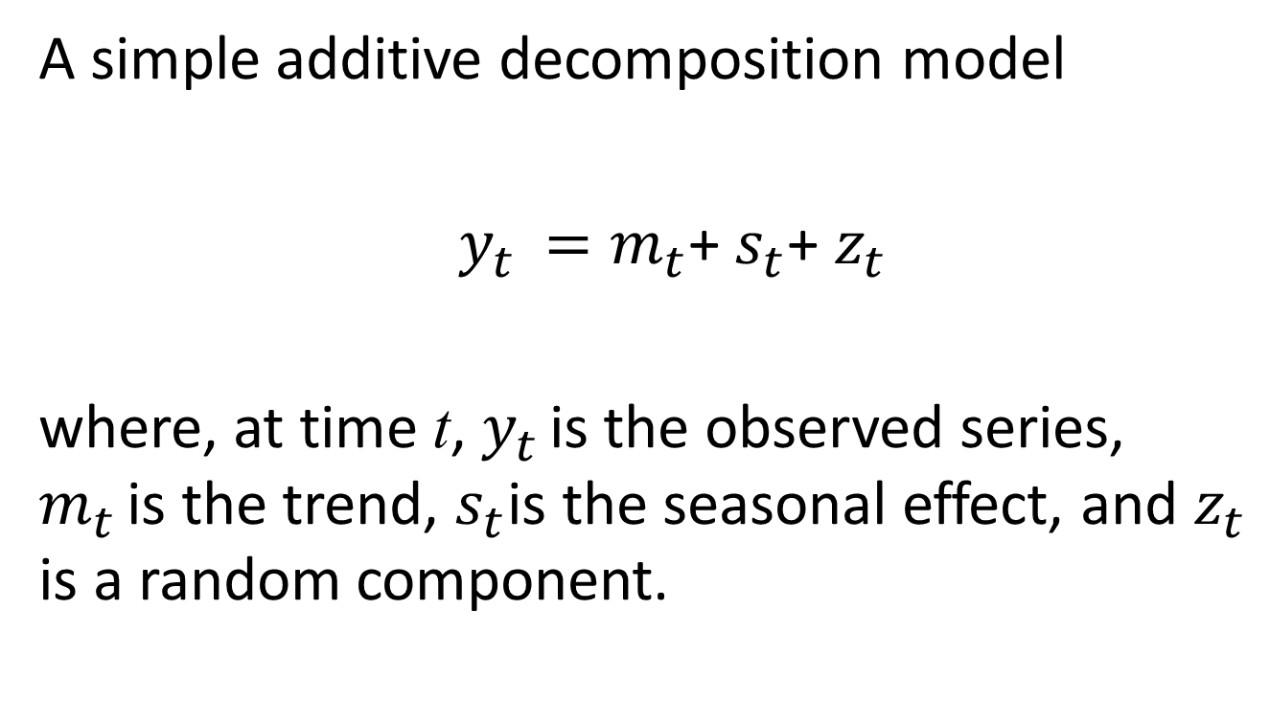
Decomposition of Series: Models
A simple additive decomposition model
$y_{t }=m_{t}$+ $s_{t}$+ $z_{t}$
where, at time t, $y_{t }$is the observed series, $m_{t }$is the trend, $s_{t}$is the seasonal effect, and $z_{t}$ is a random component.

Slide 3
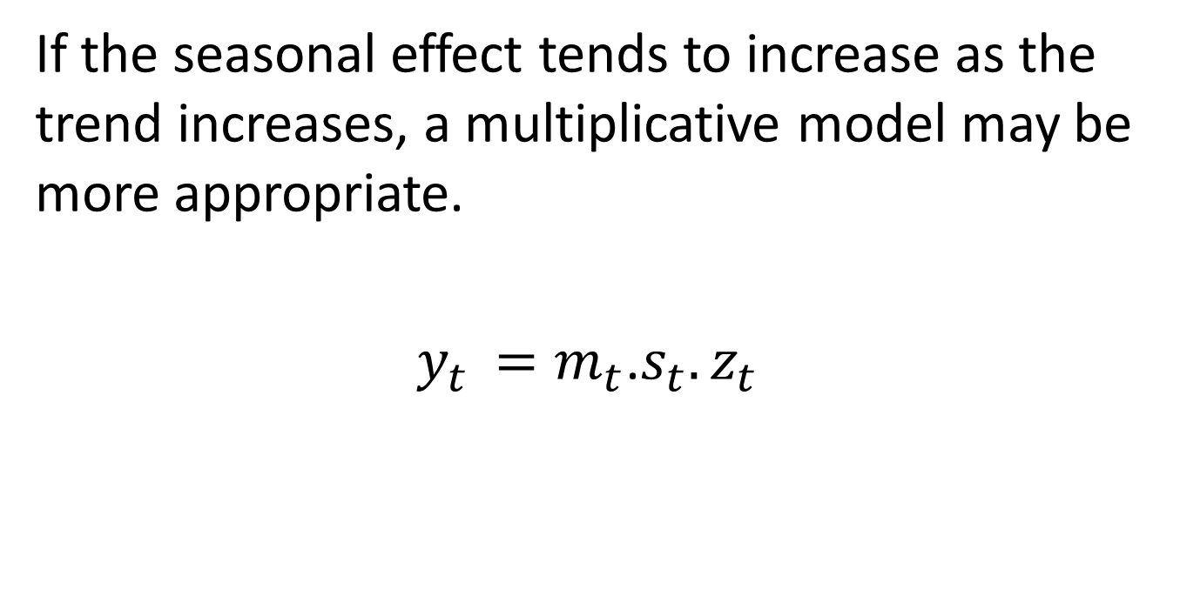
Decomposition of Series: Models
If the seasonal effect tends to increase as the trend increases, a multiplicative model may be more appropriate.
$y_{t }=m_{t}$.$s_{t}.z_{t}$

Slide 4
Functions for Decomposition Models
Two decomposition functions will be used.
decompose() function
stl() function

Slide 5
Decompose function in R
#The command decompose(seriesname)
decomposes a series into the components trend, seasonal effect, and random component.

Slide 6
Example: Electricity
The monthly supply of electricity (million of kWh), beer (MI), and
chocolate-based production (tonnes) in Australia over the period
January 1958 to December 1990.
> CBE <- read.table("C:/MA_TS/R/cbe.dat", header = T)
> CBE[1:4, ]
choc beer elec
1 1451 96.3 1497
2 2037 84.4 1463
3 2477 91.2 1648
4 2785 81.9 1595
class(CBE)
[1] "data.frame”

Slide 7
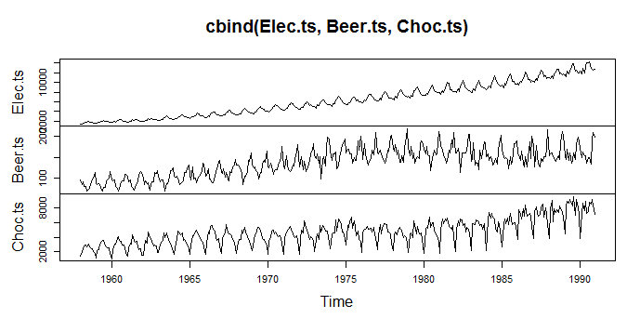
Now create time series objects for the electricity, beer and chocolate data.
If you omit end, R uses the full length of the vector, and if you omit the month in start,
R assumes 1. You can use plot with cbind to plot several series on one figure.
> Elec.ts <- ts(CBE[, 3], start = 1958, freq =12)
> Beer.ts <- ts(CBE[, 2], start = 1958, freq =12)
> Choc.ts <- ts(CBE[, 1], start = 1958, freq =12)
> plot(cbind(Elec.ts, Beer.ts, Choc.ts))

Slide 8
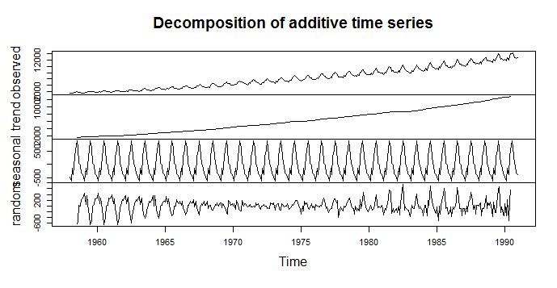
Decompose function
> plot(decompose(Elec.ts))

Slide 9
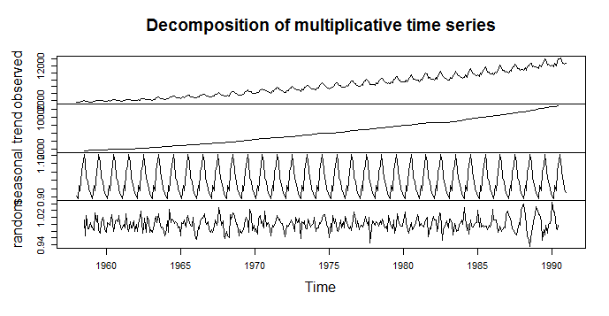
> Elec.decom <- decompose(Elec.ts, type = "mult")
> plot(Elec.decom)

Slide 10
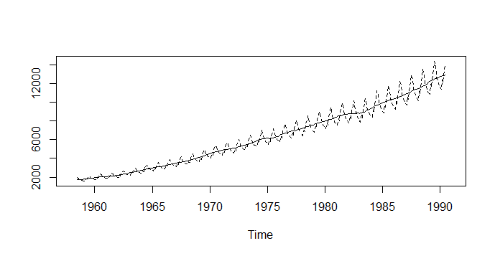
> Trend <- Elec.decom$trend
> Seasonal <- Elec.decom$seasonal
> ts.plot(cbind(Trend, Trend*Seasonal), lty = 1:2)
The command ts.plot(cbind…) produces a time plot for one or more series.

Slide 11
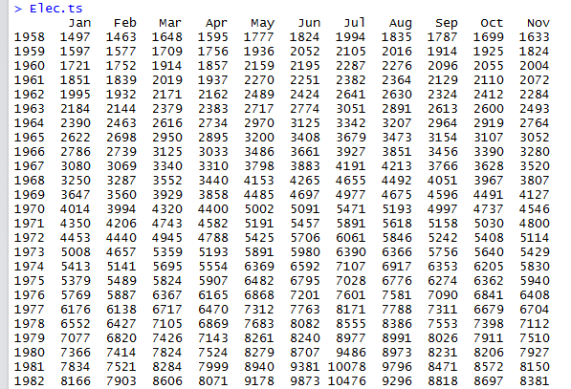

Slide 12
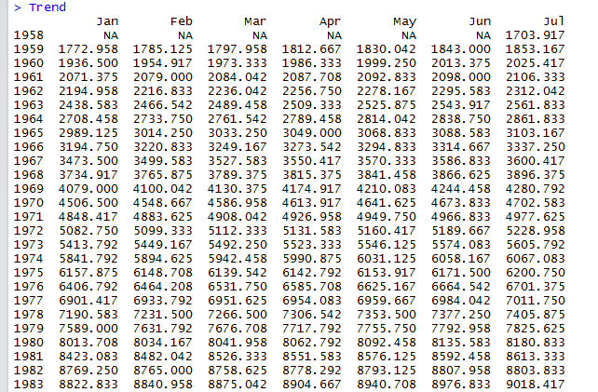

Slide 13
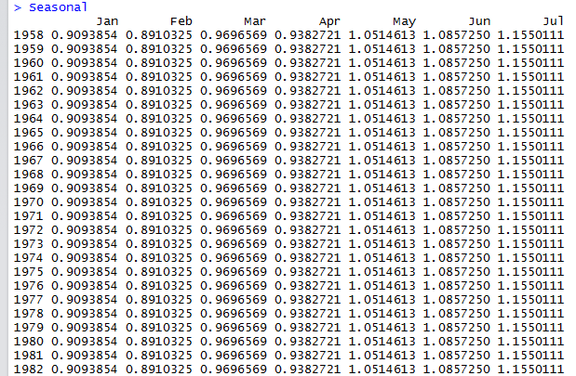

Slide 14
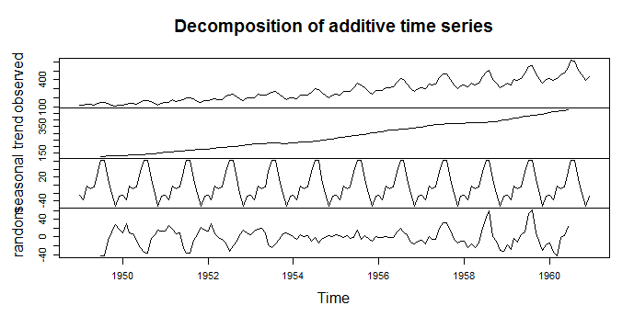
Example: Air passenger
> data(AirPassengers)
> AP <- AirPassengers
> plot(decompose(AP))

Slide 15
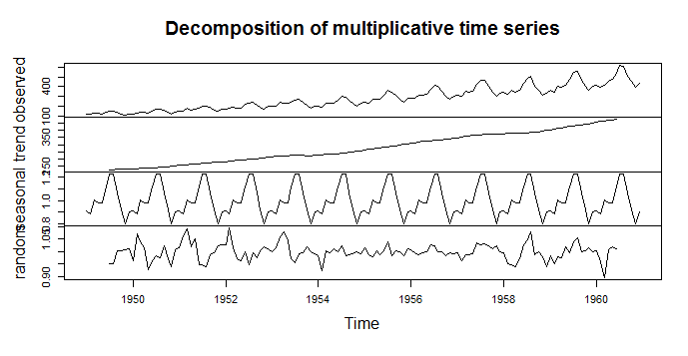
> AP.decom <- decompose(AP, type = "multiplicative")
> plot(AP.decom)

Slide 16
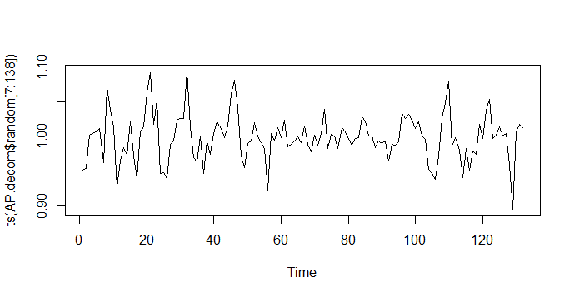
> plot(ts(AP.decom$random[7:138]))

Slide 17
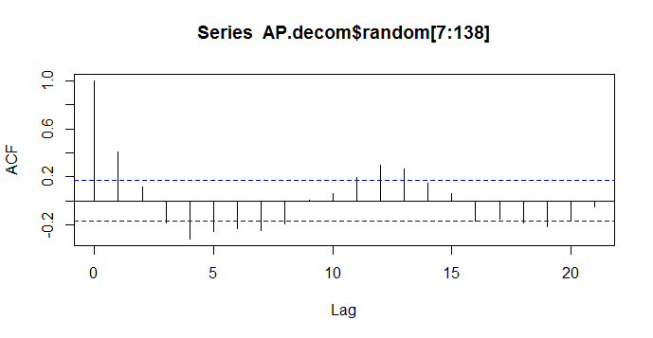
ACF
> acf(AP.decom$random[7:138])

Slide 18
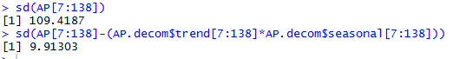
Comparing Standard deviations

Slide 19
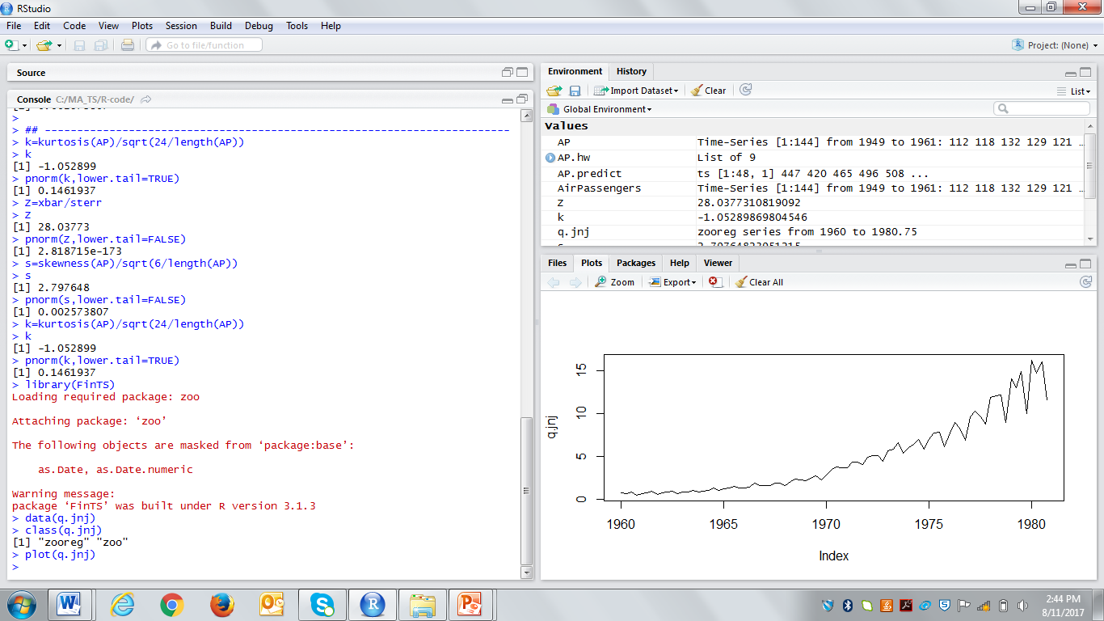
Example: Earnings data
The Johnson & Johnson quarterly earnings data, q.jnj, from the FinTS package.
First make the package FinTS available and copy the q.jnj data set into your workspace.
This is important to know; the decomposition function stl accepts zoo objects but decompose function does not.

Slide 20
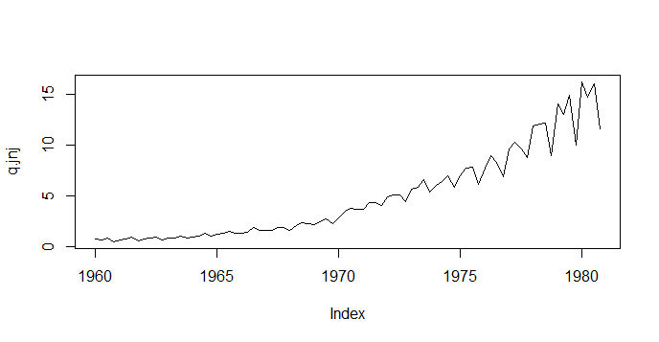
Plot
Next plot the time series to assess what components may be present (e.g. trend, seasonality etc.) in the time series. Note that your plots are recorded under the history tab.
> plot(q.jnj)
Noting that the series appears to have trend, seasonality and randomness.

Slide 21
Decompose the series
Next, We would like to use the decompose function.
Can we use this function with this series?

Slide 22
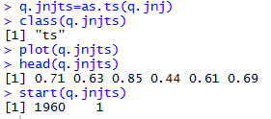
Transform a zoo object
Transformq.jnj from a zoo object to a ts object using the as.ts function.
Check that the series has been tranformed properly.

Slide 23
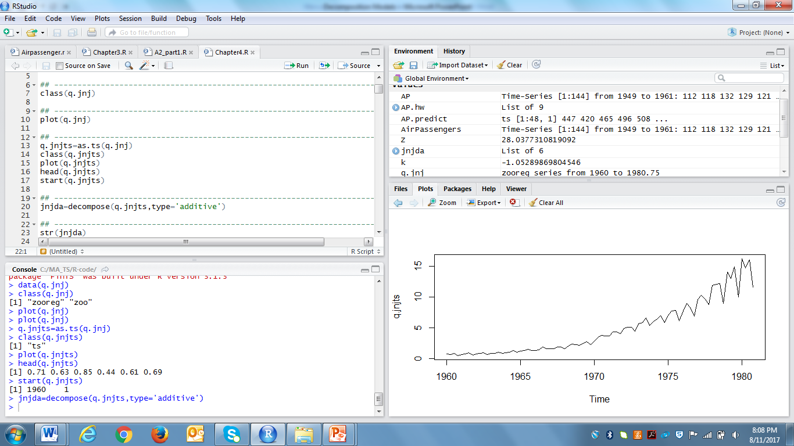
Decompose function – Additive model
Decompose q.jnjts into seasonal, trend and remainder components using the decompose function.
Let’s try the additive model.

Slide 24
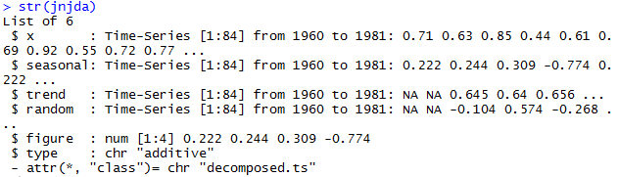
str function
Consider the structure (str) of the object returned by decompose().

Slide 25
str function
Consider the structure (str) of the object returned by decompose().

Slide 26
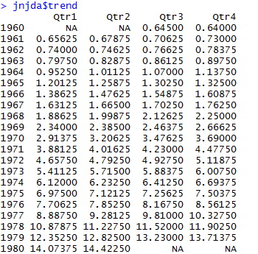
Trend component

Slide 27
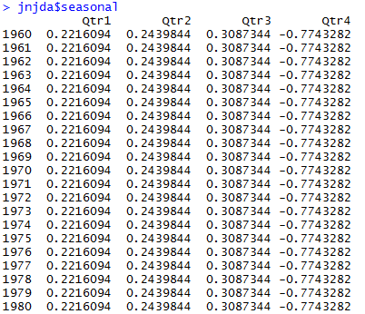
Seasonal component

Slide 28
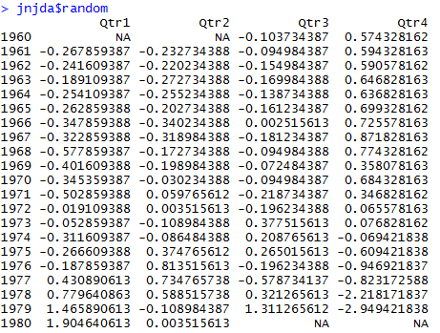
Random component

Slide 29
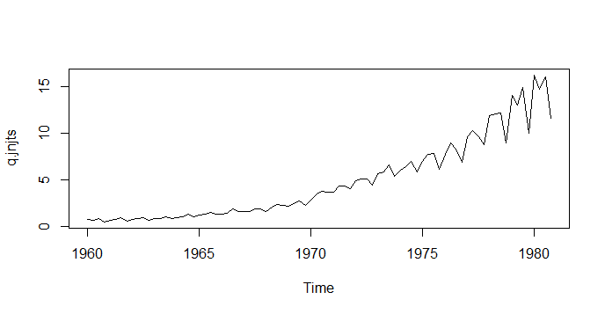
Plot original series
plot(q.jnjts)

Slide 30
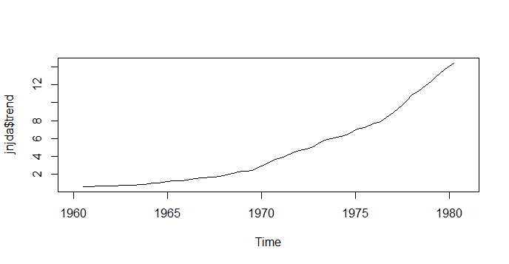
Plot the elements of the decomposition - trend
Note that we use $ to extract the specific items in the object.
plot(jnjda$trend)
Note that we lost four observations on the trend and error. Why?

Slide 31
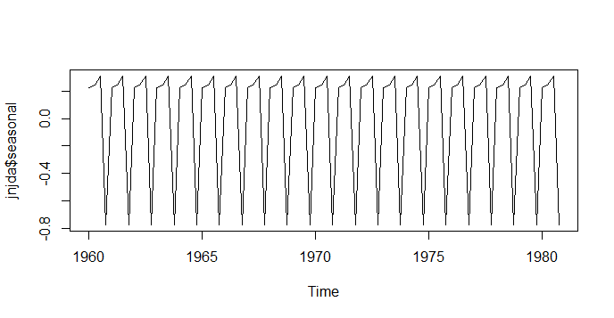
Plot the elements of the decomposition - seasonal
plot(jnjda$seasonal)

Slide 32
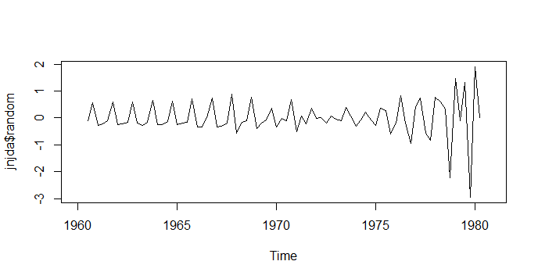
Plot the elements of the decomposition – random
plot(jnjda$random)
What do you see?

Slide 33
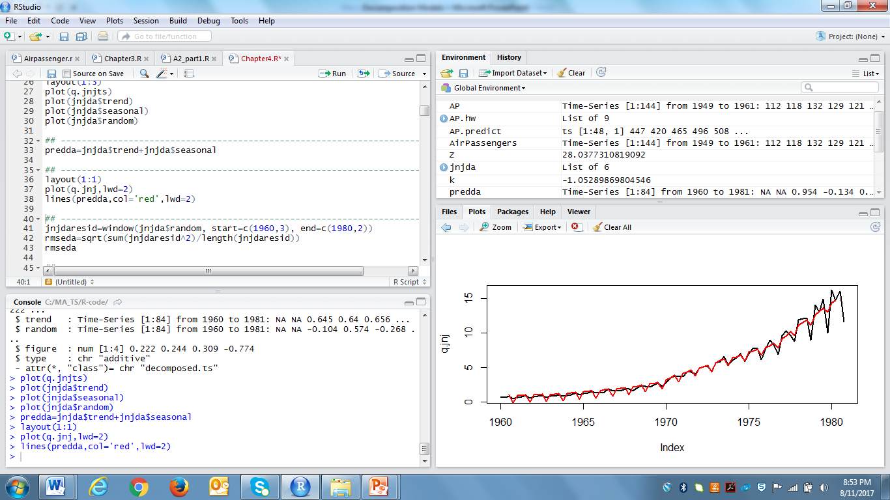
Prediction
A 'prediction' of the Johnson & Johnson earnings can be constructed by combining the seasonal and trend components. This 'predicts' the quarterly earnings at dates where we already have the actual earnings. Thus we can compute prediction errors at each date and use the errors to determine an overall measure of 'prediction goodness'. Recall we are using an additive model so we add the trend and seasonal estimates.

Slide 34
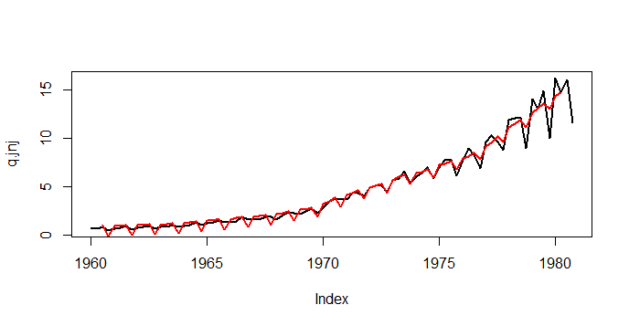
Graphical comparison
layout(1:1) plot(q.jnj,lwd=2) lines(predda,col='red',lwd=2)

Slide 35
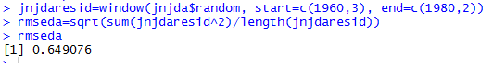
RMSE – Additive model
The random component is the actual data minus the combined trend and seasonal components.
It corresponds to estimates of the residuals or error and We can compute the root-mean-squared value of these residual.
It is the square root of the average of the sum of the squares of the remainder values.
Note that the missing values at the start and end of the series need to be accounted for.

Slide 36
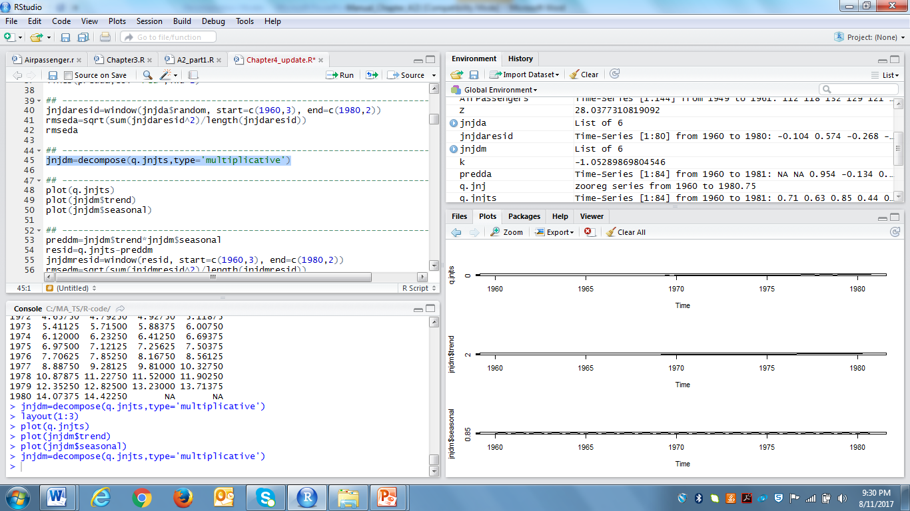
Decompose function – Multiplicative model
Why we should try this model for this series?

Slide 37
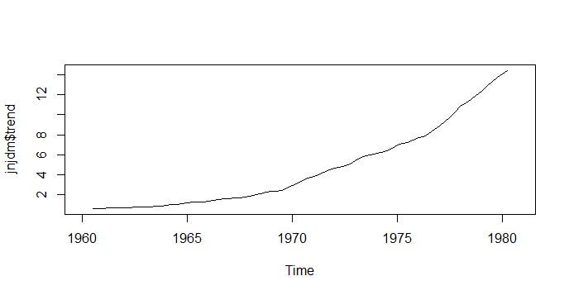
Plot the elements of the decomposition - trend
plot(jnjdm$trend)

Slide 38
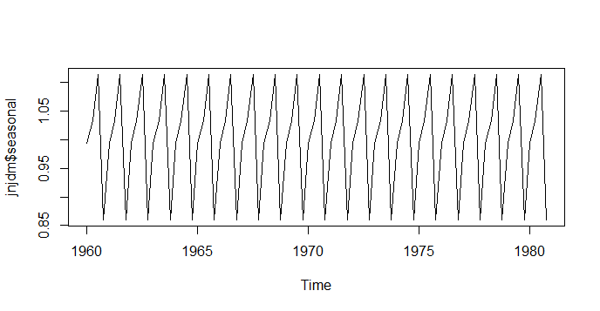
Plot the elements of the decomposition - seasonal
plot(jnjdm$seasonal)

Slide 39
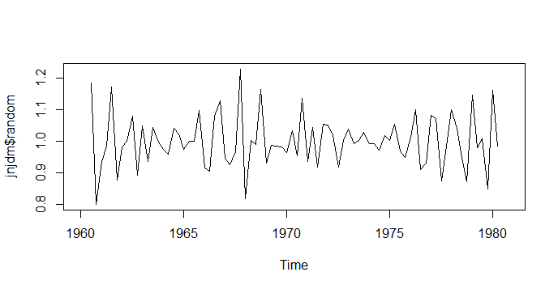
Plot the elements of the decomposition – random
plot(jnjdm$random)

Slide 40
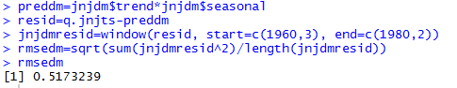
RMSE – Multiplicative model
Recall that this is a multiplicative model so we must compute the difference between the predictions (fitted values) and the observations to calculate the residuals to be used in the computation of the RMSE to compare with the additive model.

Slide 41
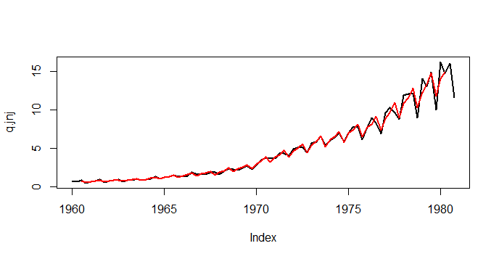
Graphical comparison
layout(1:1) plot(q.jnj,lwd=2) lines(preddm,col='red',lwd=2)

Slide 42
Revisit - Plot of random
plot(jnjdm$random)

Slide 43
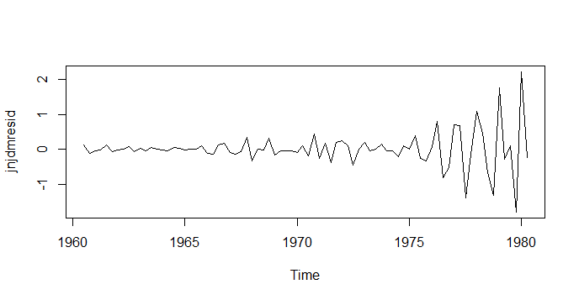
Plot of residual
plot(jnjdmresid)

Slide 44
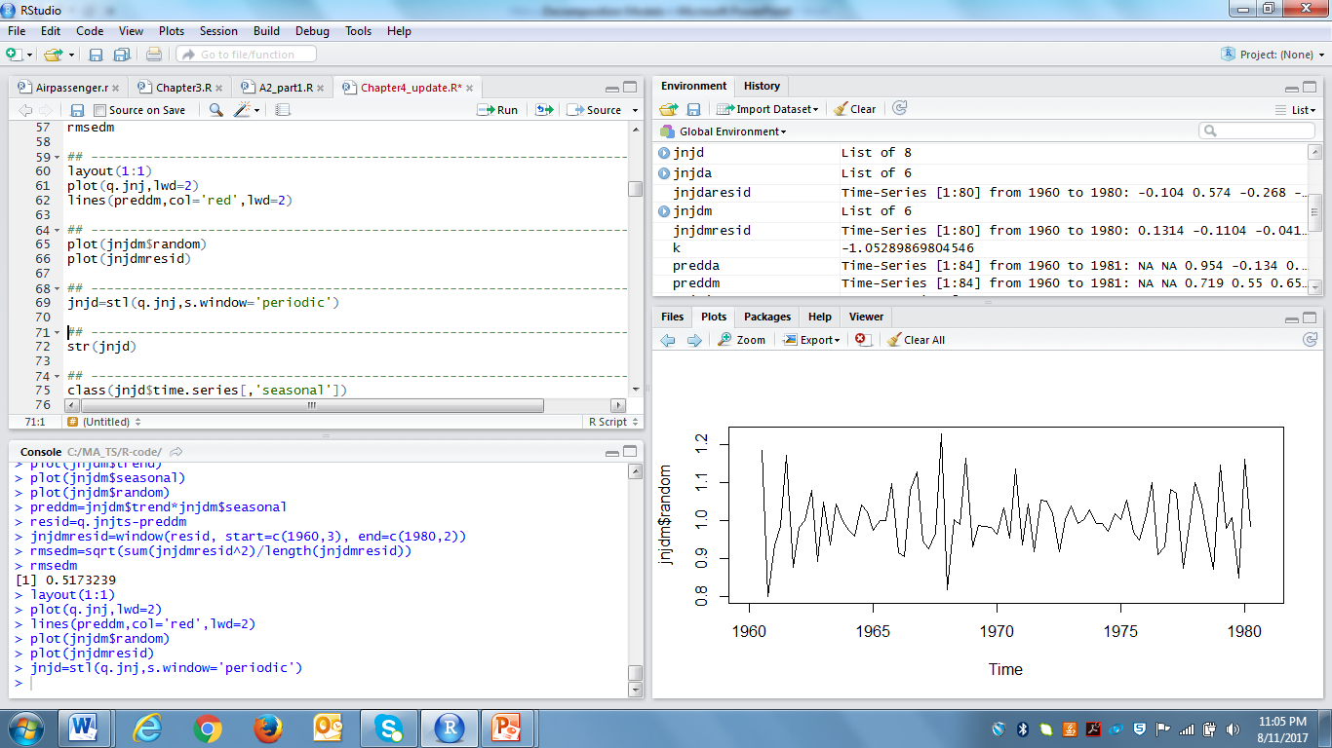
Decomposition – stl function
Now try a decomposition using stl to see if a different 'moving average' estimate, i.e. using loess regression through the function stl to estimate the trend component, provides a better fit.
Note: stl fits additive model.

Slide 45
What is LOESS?
LOESS specifically denotes a method that is also known as locally weighted polynomial regression. At each point in the range of the data set a low-degree polynomial is fitted to a subset of the data, with predictor values near the point whose response is being estimated. The polynomial is fitted using weighted least squares giving more weight to points near the point whose response is being estimated and less weight to points further away.
Source: https://en.wikipedia.org/wiki/Local_regression

Slide 46
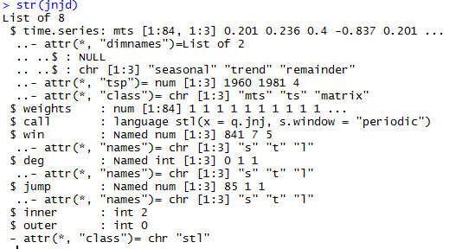
str function

Slide 47
str function

Slide 48
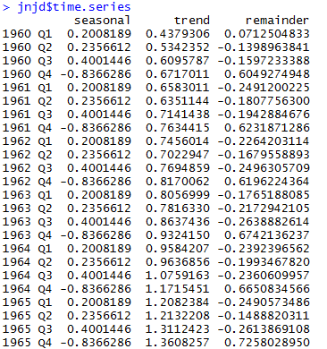

Slide 49
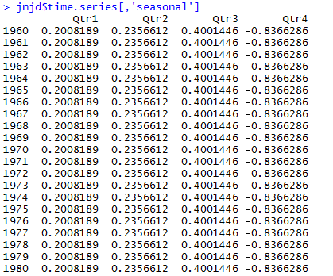
Seasonal component

Slide 50
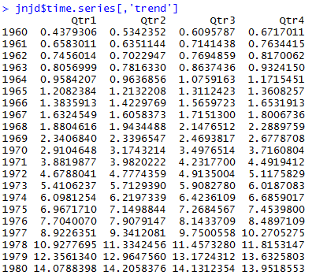
Trend component

Slide 51
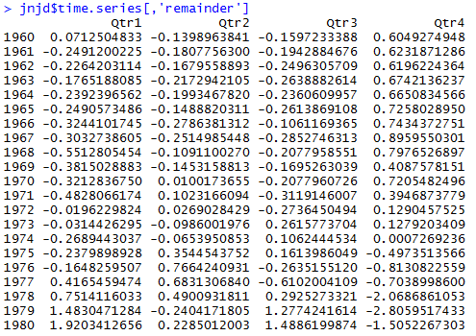
Remainder

Slide 52
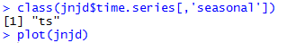
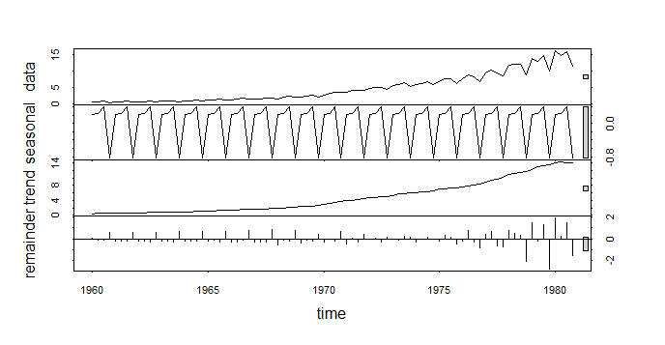
Class and Plot
Note that we get four plots. Be especially aware of the different scales of the plots. Notice the grey rectangle on the right of each plot. Can you figure out what it is indicating?

Slide 53
Grey bar
“The general idea is that if you scaled all the panels such that the grey bars were all the same size, you would be able to determine the relative magnitude of the variations in each of the components and how much of the variation in the original data they contained. But because the plot draws each component on it's own scale, we need the bars to give us a relative scale for comparison.”
Source: https://stats.stackexchange.com/questions/7876/interpreting-range-bars-in-rs-plot-stl

Slide 54
Grey bar
From our plot, the trend dominates the data series and consequently the grey bars are of similar size.
The next greatest importance is variation at the residuals (remainder).
Now consider the seasonal panel; the grey box is now much larger than either of the ones on the data or trend panel, indicating the variation attributed to the seasonal is much smaller than the trend component and consequently only a small part of the variation in the data series.
The variation attributed to the seasonal is considerably smaller than the stochastic component (the remainders). It seems that these data do not exhibit a strong seasonal pattern.
Reference: https://stats.stackexchange.com/questions/7876/interpreting-range-bars-in-rs-plot-stl

Slide 55
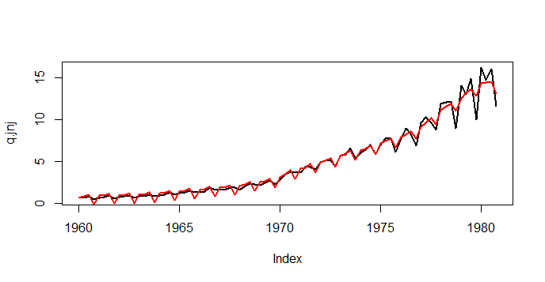
Prediction from stl function
A 'prediction' of the Johnson & Johnson earnings can be constructed by combining the seasonal and trend components as we did using the decompose function.
pred1=jnjd$time.series[,'seasonal'] + jnjd$time.series[,'trend'] plot(q.jnj,lwd=2) lines(pred1,col='red',lwd=2)

Slide 56
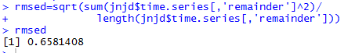
RMSE

Slide 57
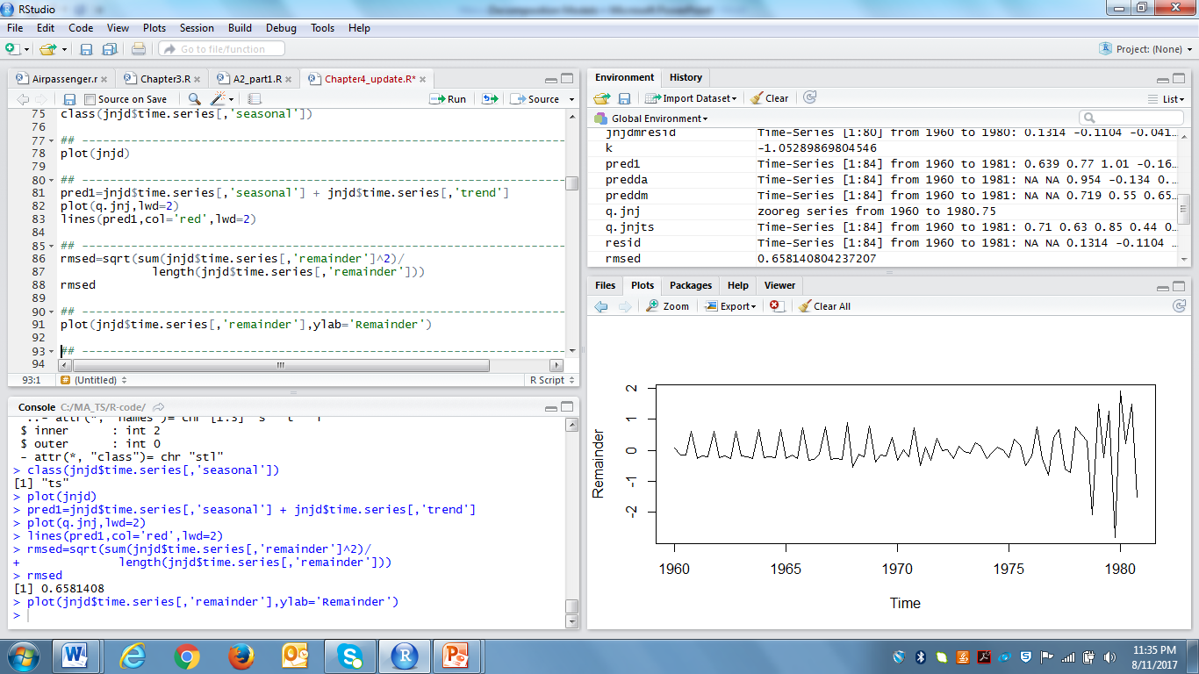
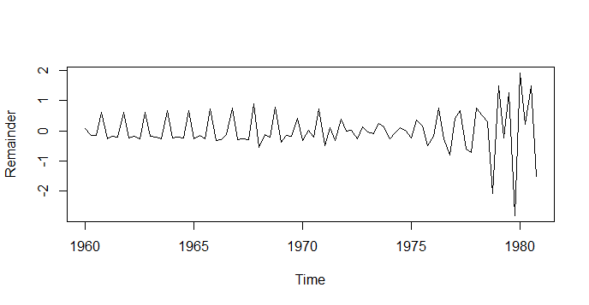
stl - remainder
We can also look at the remainder values to visualize the quality of the fit. What happens to the quality of the fit as time increases?

Slide 58
Stl – multiplicative model?
If we want to use the loess estimation for the trend component but use a multiplicative model, what we need to do?

Slide 59
Stl – multiplicative model?
We need to consider the natural log of the multiplicative model which makes it an additive model for the log of the original data series and our estimates will be of the log trend component and the log of the seasonal component.
Perform the transformation and look at the result. Note that it is still a zoo object.

Slide 60
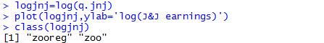
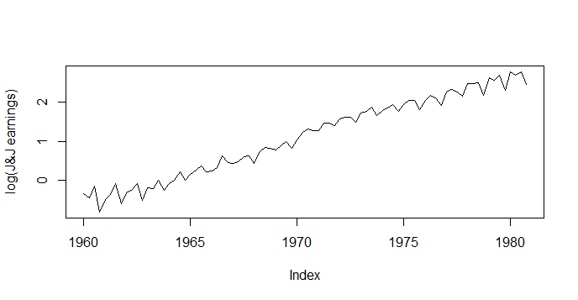
Stl – logarithm transformation

Slide 61

Stl – logarithm transformation
We can repeat the last analysis using the stl with the natural log of the data to fit a multiplicative model using loess regression to estimate the trend component.
tsjnjd=stl(logjnj,s.window='periodic')
plot(tsjnjd)

Slide 62

Stl – logarithm transformation
pred2=tsjnjd$time.series[,'seasonal']+tsjnjd$time.series[,'trend'] plot(logjnj,lwd=2) lines(pred2,col='red',lwd=2)

Slide 63

Stl – logarithm transformation
To calculate a comparable RMSE for the model, you must calcualte the difference between the original data and the exponential of the fitted values to return to the scale of the original data.

Slide 64
Stl – logarithm transformation
If we want to forecast J&J earnings beyond the last date at which we have data we need to create a forecast of the trend component. One approach is to forecast the trend component using a linear regression model. To do this we extract the trend component of the log transformed data.

Slide 65

Extract the trend
tr=tsjnjd$time.series[,'trend'] plot(tr)
What model should we fit the trend?

Slide 66

Fir the trend with log model
We want to regress the trend of the log transformed data against time so We need to extract the time values of the time series as a separate variable.

Slide 67

time function
The class of our time series is ts. The time values can be accessed with the time() function.

Slide 68

Although not strictly necessary at this point, it would be nice if our time variable did not have the 'extra' stuff that goes along with being a ts object. We can strip away everything but the time values by using the unclass function.

Slide 69

Fit the regression model
Now perform the linear regression of trend against time using the lm function (linear model). Then, print a summary of the statistical properties of the regression.

Slide 70

How good is the fit?
Plot the trend and superimpose the regression line to visualize the result.
plot(tr,lwd=2) lines(ti,fitted(trreg),col='red',lwd=2)

Slide 71

Prediction beyond the last record
Now we can use the regression model to forecast the trend component beyond the last date of our data and add the correct seasonal adjustment to get prediction.
First we create a vector containing the dates for which we want to predict values of the series.

Slide 72

We can use the predict() function to compute the predictions from a linear regression.

Slide 73
The first required parameter is the object returned by the linear regression lm(),
which for us is trreg.

Slide 74
The second required parameter is a table of values for the independent variables,
i.e. times at which the predictions are to be made.

Slide 75
This last parameter is generated using a data structure called a data.frame. The data.frame identifies the independent variables in the regression that you are supplying new data for: in our case we are going to supply values for the ti variable along with the new values for that variable. All of this is accomplished with the parameter statement data.frame(ti=predtime).

Slide 76
The parameter in the predict function, se.fit=TRUE tells the predict function
to compute standard errors for the predictions.

Slide 77
Add seasonal component
To construct J&J earnings predictions from the predicted trend values and the seasonal component.
Look at the last few values of the seasonal component and determine which seasonal values go with the times you want to predict.
Construct a vector of the seasonal values for those times.
Then combine the appropriate seasonal values with the predicted trend component values.

Slide 78


Add seasonal component

Slide 79

Confidence Interval
To obtain 95% confidence intervals for the predictions, use +/- two standard errors from the trend predictions and transform all the values back to the original earnings scale by exponentiating accordingly.

Slide 80

Plot 1 (entire series and predictions in log scale)
plot(ti,logjnj,ylim=c(-3,5),xlim=c(1960,1983),type='l')
lines(ti,fitted(trreg),col='red')
points(predtime,spredvalues,col='red',pch=19,cex=.8)
lines(predtime,predupperse,col='blue',lwd=2)
lines(predtime,predlwrse,col='blue',lwd=2)

Slide 81

Plot 2 (just the prediction in log scale)
plot(predtime,spredvalues,ylim=c(2,5),col='red',type='l') lines(predtime,predupperse,col='blue',lwd=2) lines(predtime,predlwrse,col='blue',lwd=2)

Slide 82

Plot 3 (entire series and predictions in original scale)
plot(ti,q.jnj,ylim=c(-5,23),xlim=c(1960,1982),type='l') points(predtime,epredvalues,col='red',pch=19) lines(predtime,epredupperse,col='blue',lwd=2) lines(predtime,epredlwrse,col='blue',lwd=2)

Slide 83

Plot 4 (predictions in original scale)
plot(predtime,epredvalues,ylim=c(15,23),col='red', type='l',lwd=2) lines(predtime,epredupperse,col='blue',lwd=2) lines(predtime,epredlwrse,col='blue',lwd=2)

